Slide 1
TRENDS IN SOFTWARE TESTING AND JOB DESCRIPTION
Created By:- Dhruvin, Krinal, Pratibha

Slide 2

CONTENTS
Current Trends in Software Testing
Upcoming Trends in Software Testing
Job Description
Skills Required

Slide 3
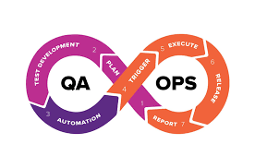
CURRENT TRENDS IN SOFTWARE TESTING
Evolution Of DevOps
Increasing Automation
Agile Methodology

Slide 4
EVALUATION OF DEVOPS
The DevOps methodology brings cooperation and communication between development and operations teams, ensuring that software is built and deployed more quickly and with fewer errors.
DevOps ensuring that programs are properly tested before being made available.

Slide 5

INCREASING AUTOMATION
Automation is becoming vital to software testing, freeing testers to work on more challenging and innovative projects.
75% of software testing tasks are already automated, according to a Capgemini report, and this number is projected to rise over the next several years.

Slide 6
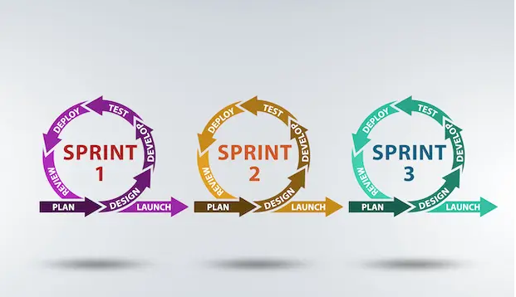
AGILE METHODOLOGY

Slide 7
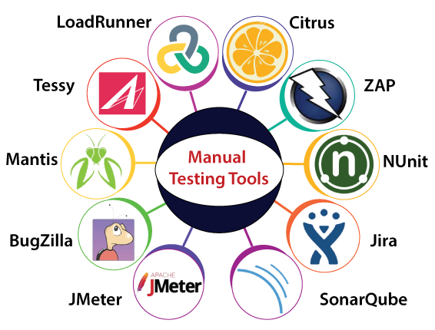

Slide 8

UPCOMING TRENDS IN SOFTWARE TESTING
Artificial Intelligence (AI) and Machine Learning (ML) in testing.
Synthetic Data (AI-driven synthetic data)
Robotic Process Automation (RPA)

Slide 9
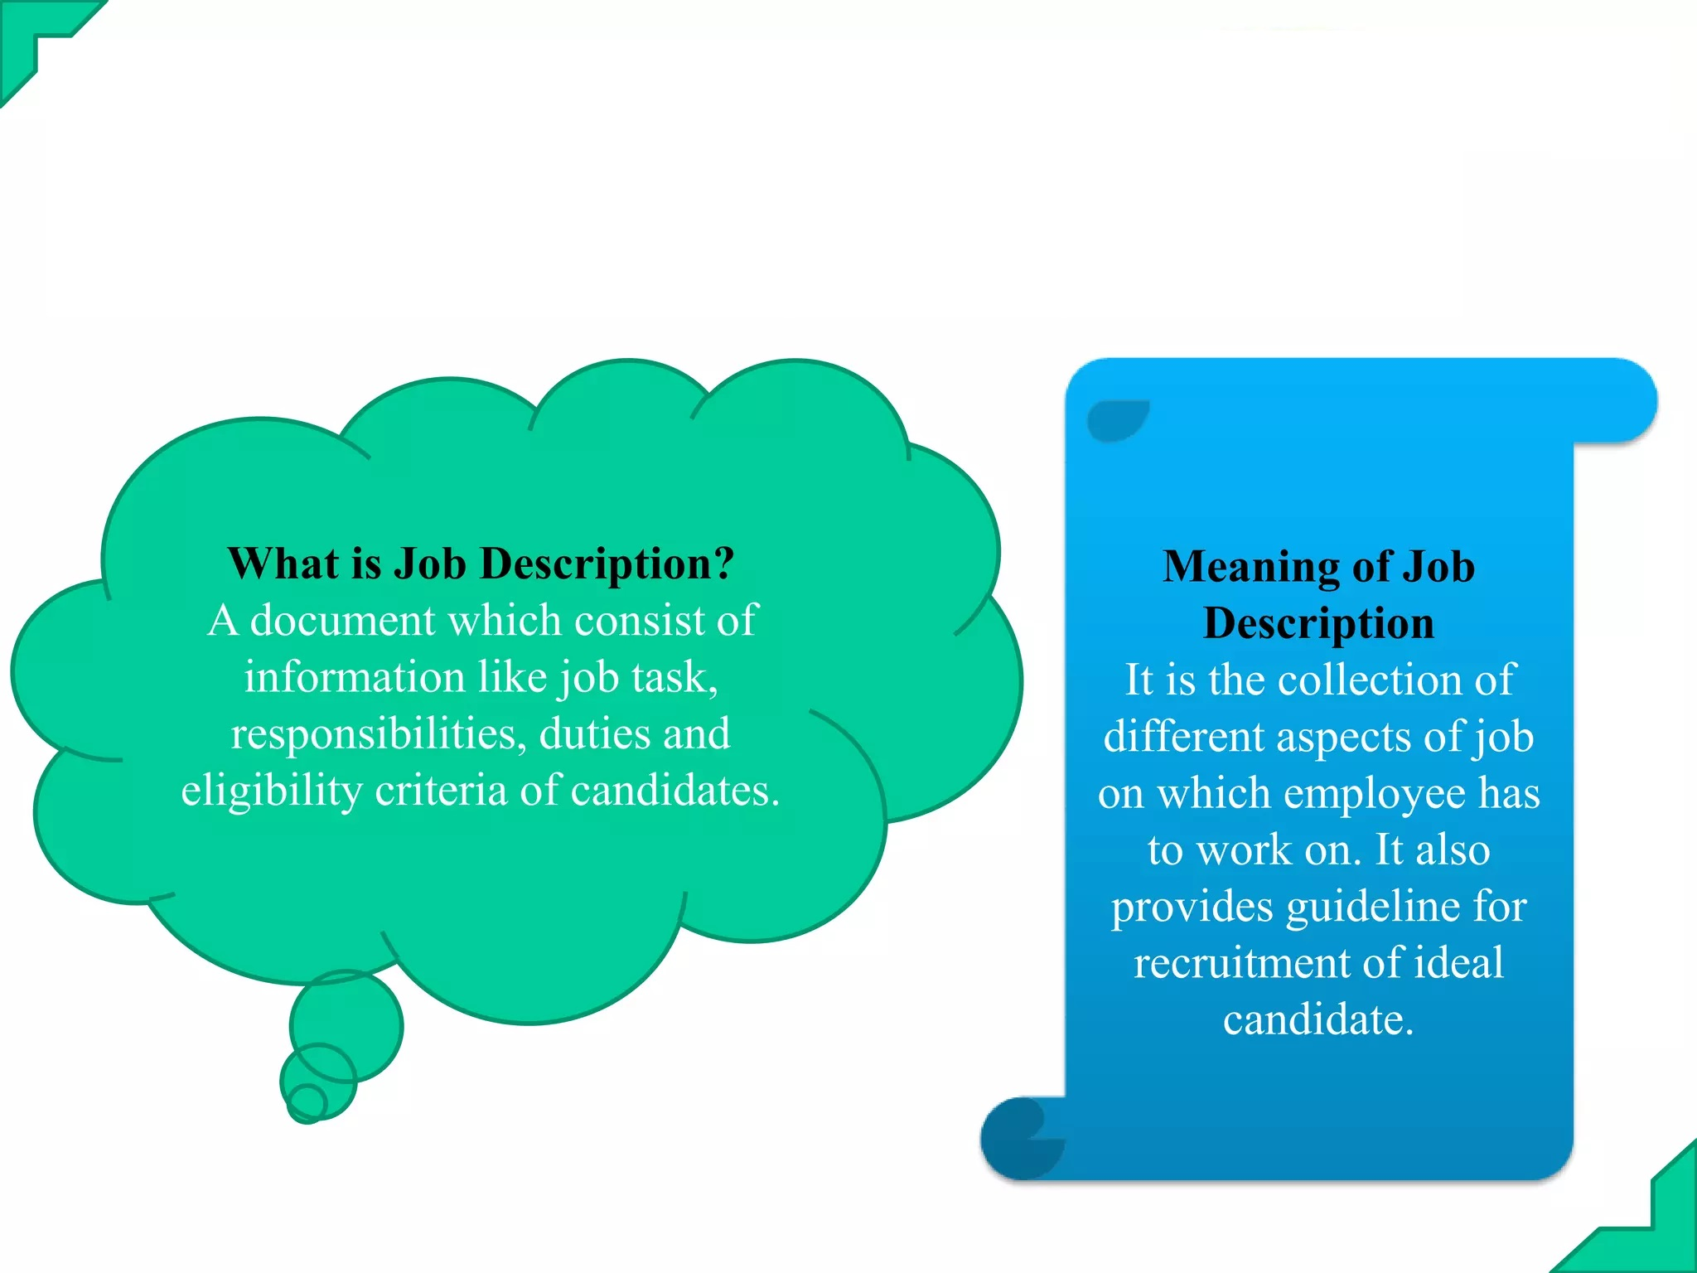
JOB DESCRIPTION

Slide 10
Roles In Software Testing
Product Owner
Team Leader
Developer
Tester
End User

Slide 11
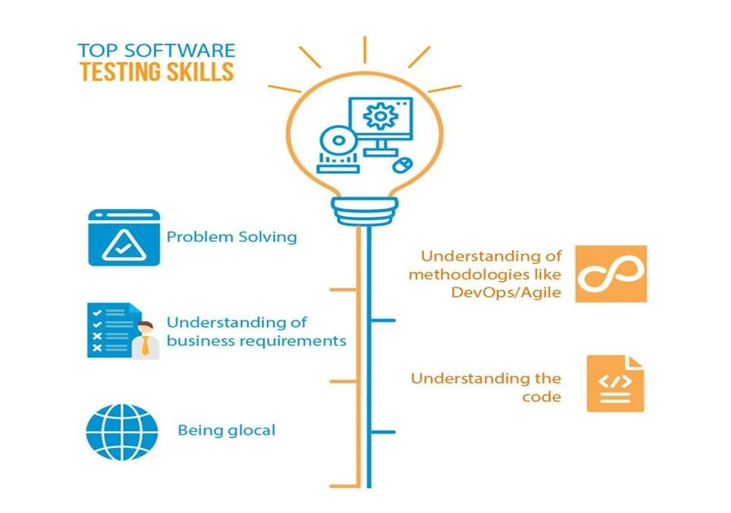

Slide 12


